Slide 1
Machine Learning for Data Scientist
https://goo.gl/p3bT54
By ASKS Data Science Group
Kanda Tiwatthanont
kanda@tni.ac.th

Slide 2
Overview
Data Science Process
Data Scraping
Data Preparation
Data Exploratory

Slide 3
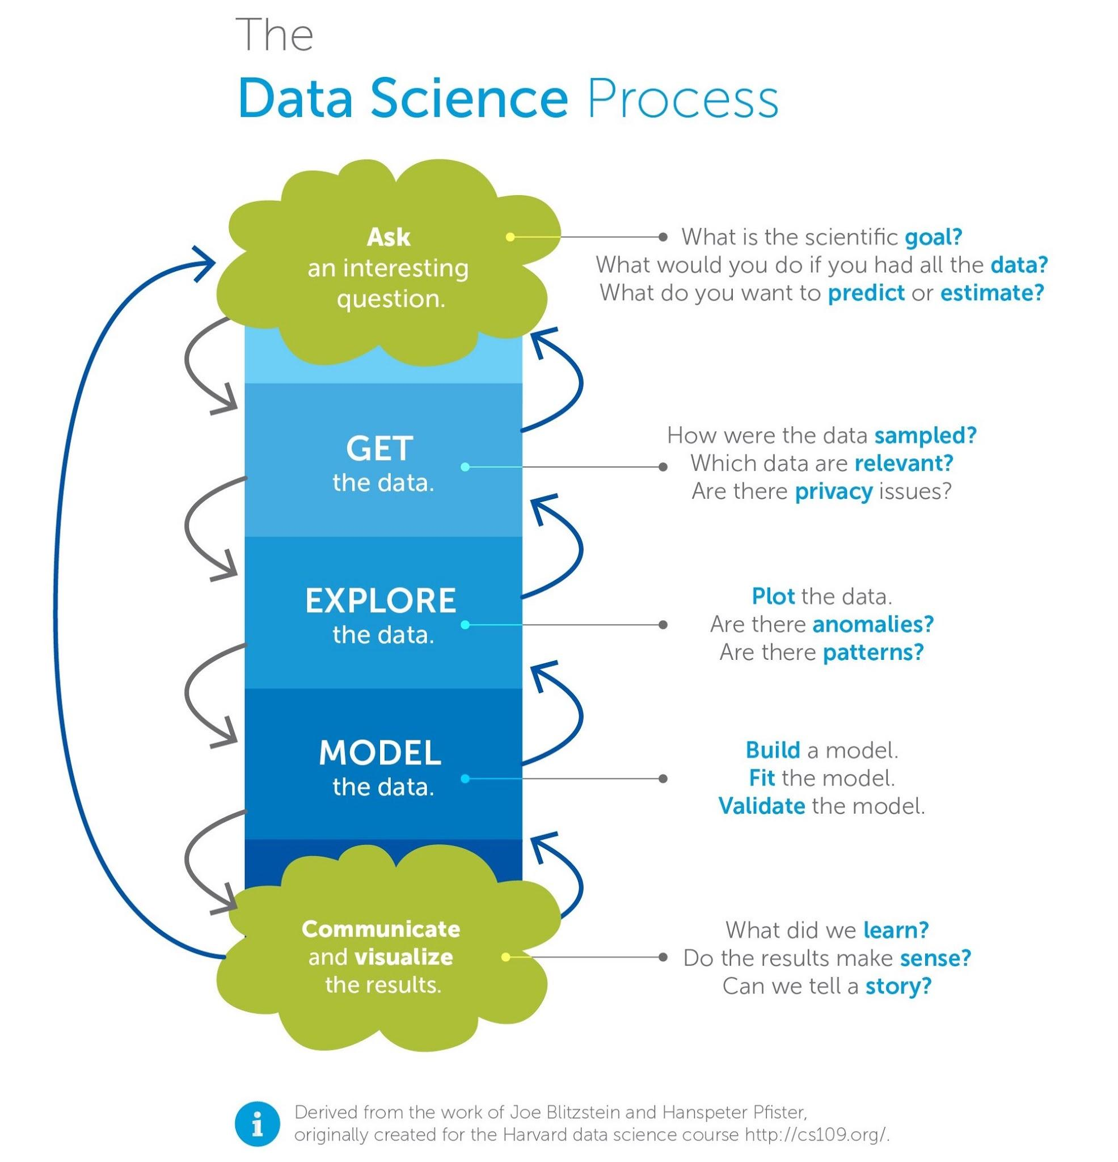
What a business
need to analytic?
- What is the scientific goal?
- What would you do if you had all the data?
- What do you want to predict or estimate?
1
Do I have enough data / information to analytic?
2
- How were the data sampled?
- Which data are relevant?
- Plot the data
- Are there correct?
- Are there anomalies?
Do I have enough good data to start building the model?
3
- Build a model
- Fit the model
- Validate the model
4
Do I have a good idea about the type of model to try?
- What did we learn?
- Do the result make sense
- Can we tell a story?
Is the model robust enough? Have we failed enough
5
Notes:
https://medium.freecodecamp.org/i-ranked-all-the-best-data-science-intro-courses-based-on-thousands-of-data-points-db5dc7e3eb8e
https://cdn-images-1.medium.com/max/2000/1*ius9T3uGkd743dljInNF8w.jpeg

Slide 4
Do I have enough data / information to analytic?
2
- How were the data sampled?
- Which data are relevant?
- Plot the data
- Are there correct?
- Are there anomalies?
Do I have enough good data to start building the model?
3
Notes:
https://medium.freecodecamp.org/i-ranked-all-the-best-data-science-intro-courses-based-on-thousands-of-data-points-db5dc7e3eb8e
https://cdn-images-1.medium.com/max/2000/1*ius9T3uGkd743dljInNF8w.jpeg

Slide 5





Data Scraping
2
BeautifulSoup
API
3
Data Exploratory & Preparation
Pandas
Seaborn
SQLite
Notes:
https://medium.freecodecamp.org/i-ranked-all-the-best-data-science-intro-courses-based-on-thousands-of-data-points-db5dc7e3eb8e
https://cdn-images-1.medium.com/max/2000/1*ius9T3uGkd743dljInNF8w.jpeg

Slide 6
Data
Scraping

Slide 7




Data Scraping
Transactions (e.g. shop)
Social Media (e.g. Facebook)
Stream Data
Image/Video
GPS
Environmental
Industrial
Exhaust Data ( the trail of data left by online activities )
Web logs
Network logs

Slide 8
Web Scraping with BeautifulSoup
Get / Extract information from the target, e.g., website.
All elements of the target page are converted to structured data.
The data may be kept in a CSV file or database.
Methodology:
First, turn the website into a Python object called “soup”.
Second, parse the soup into structured data.

Slide 9
Data
Scraping
Let’s Start
BeautifulSoup

Slide 10
Web Scraping Hand-on
Step 1. First of all, you will have to install Beautifulsoup and Requests
Step 2. Find the URL you want to scrape
Step 3. Define what information you want to scrape
Step 4. Identify the structure of the sites HTML
Step 5. Write the scraping code for retrieving the “soup”
Step 6. Extract the information from the “soup”
Notes:
www.thairsc.com/th/BigAccidentAll.aspx?l-th

Slide 11
Web Scraping Libraries
Step 1. First of all, you will have to install Beautifulsoup and Requests
Installing Beautiful Soup
If you run Debian or Ubuntu, you can install Beautiful Soup with the system package manager apt-get install python-bs4
Beautiful Soup 4 is published through PyPi, so you can install it with pip. pip install beautifulsoup4

Slide 12
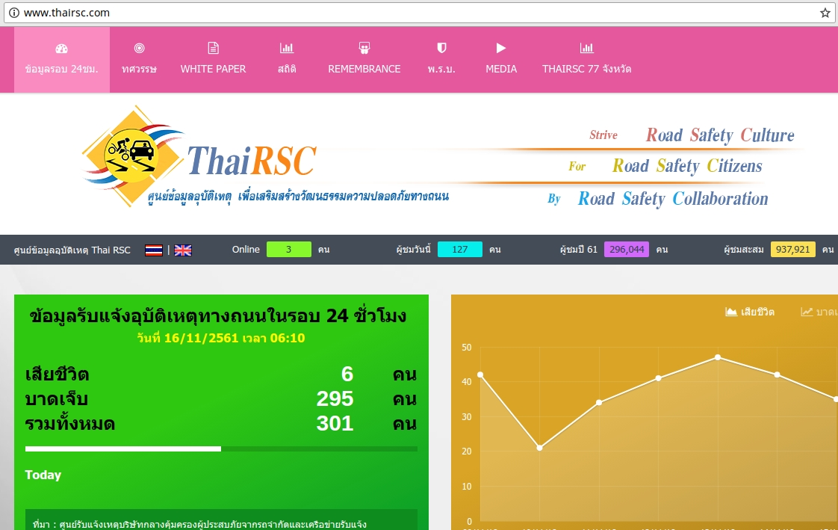
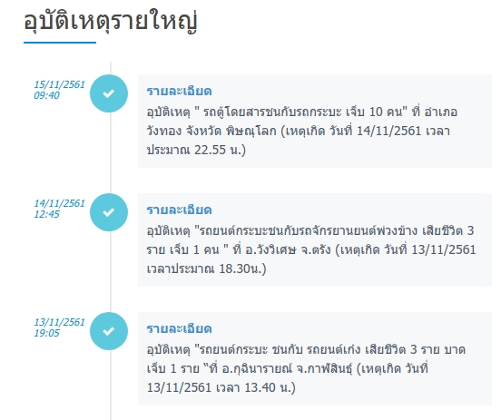
Web Scraping
Step 2. Find the URL you want to scrape
http://www.thairsc.com

Slide 13
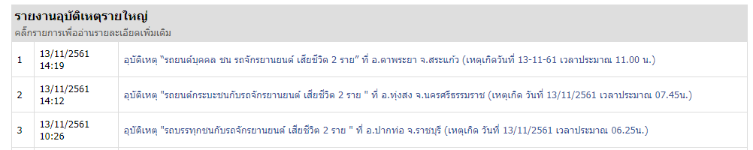
Web Scraping
Step 3. Define what information you want to scrape
1
2
3

Slide 14
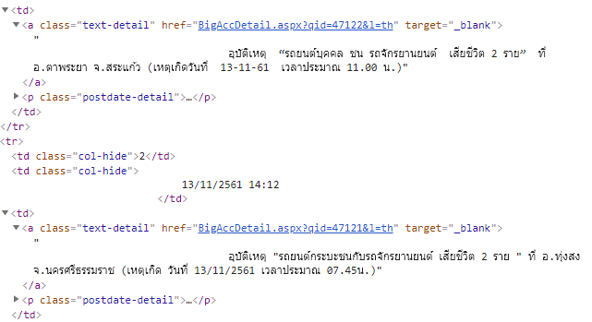
Web Scraping
Step 4. Identify the structure of the sites HTML

Slide 15


Web Scraping usage
Step 5. Write the scraping code for retrieving the “soup”
Requests
Beautiful Soup

Slide 16
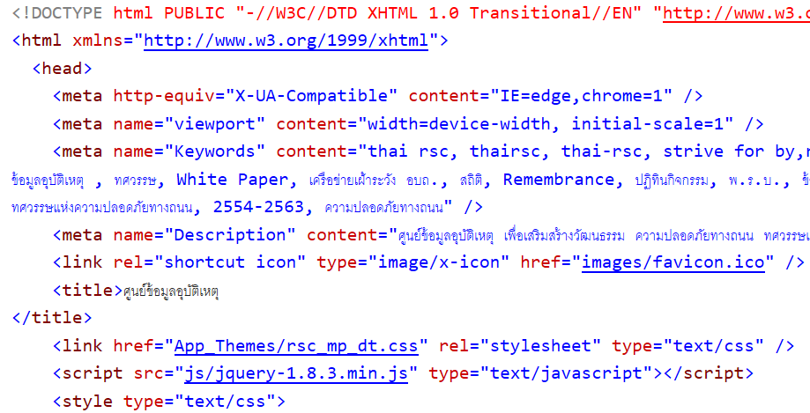
Python object called “soup”

Slide 17
Web Scraping - RegEx
Step 6. Extract the information from the “soup”
We need a Regular Expression (RegEx) for searching pattern to find a set of strings.
Regular expressions are specially encoded text strings used as patterns for matching sets of strings.

Slide 18
Extract the information
'We just received 10.00 dollars for cookies.'
>>> import re >>> x = 'We just received 10.00 dollars for cookies.' >>> y = re.search( 'dollars' , x ) >>> print(y)
['dollars']

Slide 19
Extract the information
'We just received 10.00 dollars for cookies.'
>>> import re >>> x = 'We just received 10.00 dollars for cookies.' >>> y = re.search( '[0-9.]+ dollars' , x ) >>> print(y)
['10.00 dollars']

Slide 20
Extract the information
'We just received 10.00 dollars for cookies.'
>>> import re >>> x = 'We just received 10.00 dollars for cookies.' >>> y = re.search( r'[\d.]+ dollars' , x ) >>> print(y)
['10.00 dollars']

Slide 21
Extract the information
อุบัติเหตุ "รถจักรยานยนต์ ชนกับ รถพ่วง เสียชีวิต 2 ราย"
ที่ อ.เมือง จ.สระแก้ว (เหตุเกิด วันที่ 20/11/2561 เวลา 17.20 น.)
อุบัติเหตุ "รถจักรยานยนต์ ชนกับ รถพ่วง เสียชีวิต 2 ราย"
ที่ อ.เมือง จ.สระแก้ว (เหตุเกิด วันที่20-11-61 เวลา 17.20 น.)

Slide 22
Extract the information
อุบัติเหตุ "รถจักรยานยนต์ ชนกับ รถพ่วง เสียชีวิต 2 ราย"
ที่ อ.เมือง จ.สระแก้ว (เหตุเกิด วันที่ 20/11/2561 เวลา 17.20 น.)
>>> x = 'อุบัติเหตุ “รถจักรยานยนต์…(เหตุเกิด วันที่ 20/11/2561 เวลา 17.20 น.) '
>>> re_date = re.compile(r"วันที่\s*(\d+)[/-](\d+)[/-](\d+)") >>> mdate = re_date.search(x.string)
>>> print( mdate.group(1) ) #วัน
>>> print( mdate.group(2) ) #เดือน
>>> print( mdate.group(3) ) #ปี

Slide 23
Regular Expression Quick Guide
^ Matches the beginning of a line
$ Matches the end of the line
. Matches any character
\s Matches whitespace
\S Matches any non-whitespace character
* Repeats a character zero or more times
*? Repeats a character zero or more times (non-greedy)
+ Repeats a character one or more times
+? Repeats a character one or more times (non-greedy)
[aeiou] Matches a single character in the listed set
[^XYZ] Matches a single character not in the listed set
[a-z0-9] The set of characters can include a range
( Indicates where string extraction is to start
) Indicates where string extraction is to end

Slide 24
Using find() VS. re.search()
hand = open('mbox-short.txt')
for line in hand:
line = line.rstrip()
if line.find('From:') >= 0:
print line
import re hand = open('mbox-short.txt') for line in hand: line = line.rstrip() if re.search('From:', line) : print line

Slide 25
Using startwith() VS. re.search()
hand = open('mbox-short.txt') for line in hand: line = line.rstrip() if line.startswith('From:') : print line
import re hand = open('mbox-short.txt') for line in hand: line = line.rstrip() if re.search('^From:', line) : print line

Slide 26
Fine-Tuning Your Match
X-Sieve: CMU Sieve 2.3 X-DSPAM: Result: Innocent
ABC
^X.*:
many time
Match the start of the line
Match any character

Slide 27
Fine-Tuning Your Match
X-Sieve: CMU Sieve 2.3 X-DSPAM: Result: Innocent
ABC
^X-\S+:
1 or more time
Match the start of the line
Match any non-whitespace

Slide 28

Hand-on
Web Scraping with BeautifulSoup
Open new jupyter notebook

Slide 29
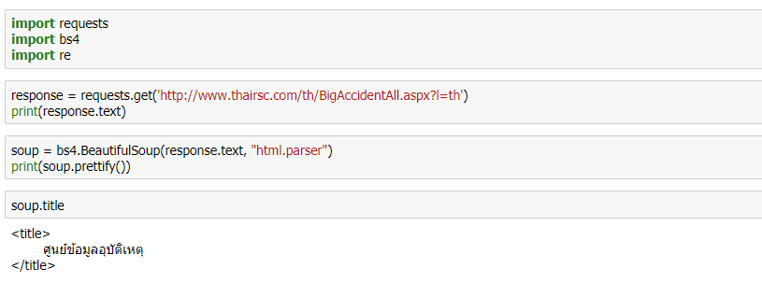
Web Scraping with Beautiful Soup

Slide 30
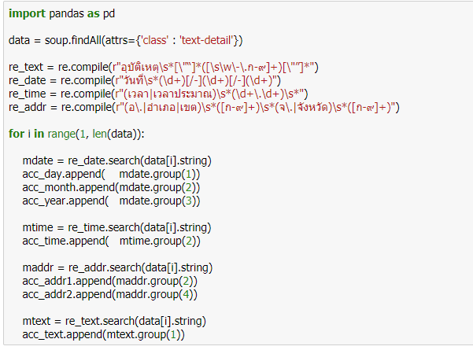
Regular expression for search pattern
https://goo.gl/aGuPBy

Slide 31

Data
Storage

Slide 32
Data Storage
SQL (Structured Query Language)
A standard programming language that is used to manage relational databases.
The operations are comprised of create, read, update, and delete.
SQLite Database
Self-contained
Serverless
Zero-configuration

Slide 33

Hand-on
Data Storage to SQLite
Open jupyter notebook

Slide 34
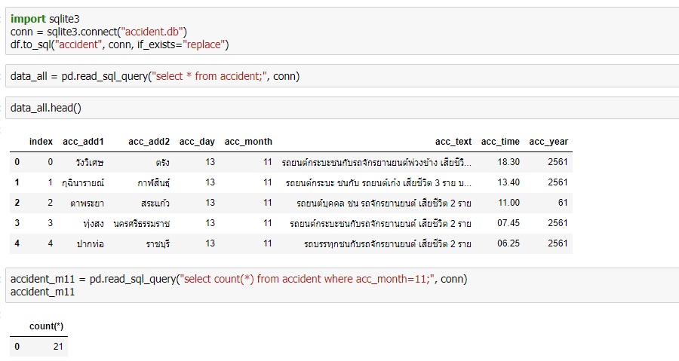
Working with SQLite using Python and Pandas

Slide 35
Data
Scraping
Scraping data from Twitter

Slide 36
Twitter API
Streaming APIs Once a request for information is made, the Streaming APIs provide a continuous stream of updates with no further input from the user. (Tweets in real-time)
Search API The Twitter Search API searches against a sampling of recent Tweets published in the past 7 days.

Slide 37
What types of information can we extract?
Twitter Search API
Information about a publisher user
User’s Followers or Friends count
Tweets published by a user
Places & Geo
Created_at
Language
Retweet

Slide 38
Twitter developers
Website: https://dev.twitter.com/
API resource documentation: https://dev.twitter.com/docs
Twitter libraries: https://dev.twitter.com/docs/twitter-libraries

Slide 39
Hand-on
Web Scraping with Twitter API
Open jupyter notebook

Slide 40
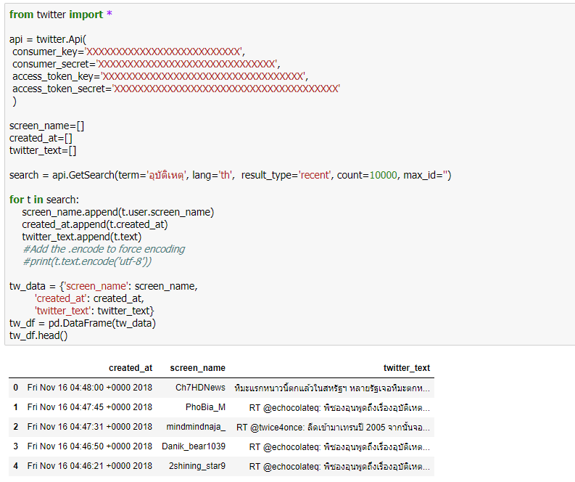
Twitter Search API

Slide 41
Overview
Data Science Process
Data Scraping
Data Preparation
Data Exploratory

Slide 42

Data Preparation

Slide 43
Data Preparation
Data Preparation is the process of cleaning, validating, Transforming, consolidating, and integrating data into a dataset or data table, primarily for use in analysis
Data Preparation is a fundamental step for a successful data analysis process
To guarantee that data set are:
Accurate;
Consistent;
Complete; and
Arranged to simplify coding and tabulation

Slide 44
Data Preparation
To ensure the accuracy of the data and their conversion from raw form to reduced and classified forms that are more appropriate for analysis
Data cleaning
Handling invalid or missing values
Eliminating duplicate rows
Formatting properly
Data transformation
Noise and outlier detection
Feature engineering

Slide 45
Hand-on
Data Preparation with Python

Slide 46
Overview
Data Science Process
Data Scraping
Data Preparation
Data Exploratory

Slide 47
Data Exploratory

Slide 48
Data Exploration
To Understand the data
Initial insight about data
Descriptive statistics (Mean, Standard Deviation, Range, etc.)
Visualization
Additional data collection to fill gaps, if needed

Slide 49
Hand-on
Data Exploratory with Python

